Slide 1
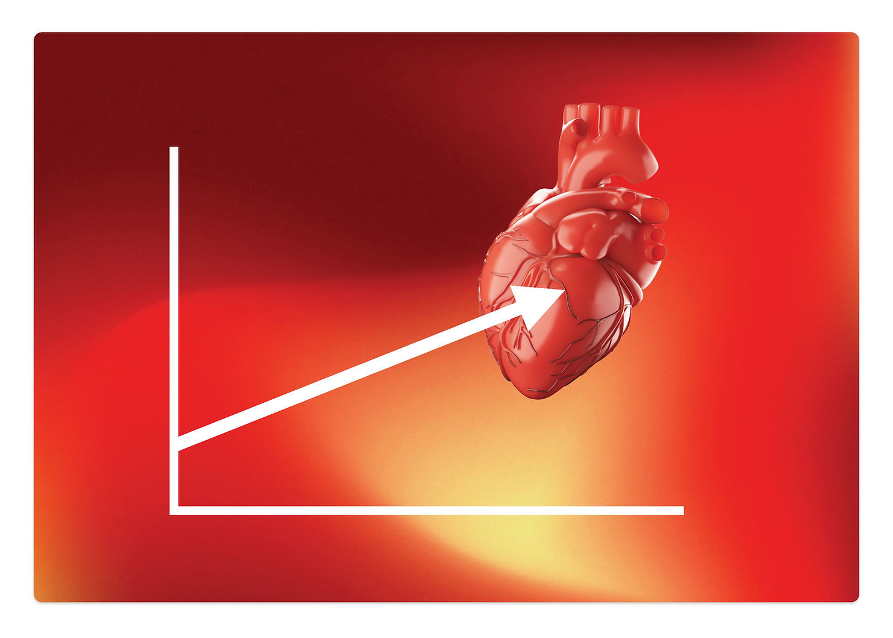
A Different Way of Visualizing
Cardiovascular Function
James Munis, MD, PhD
Departments of
Anesthesiology and Perioperative Medicine.
Physiology and Biomedical Engineering
Mayo Clinic Rochester (emeritus)

Slide 2
Disclosures:
None

Slide 3
Something OLD and Something NEW
A DIFFERENT way
of visualizing
Cardiovascular Function

Slide 4
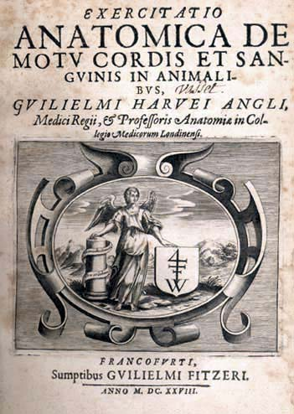
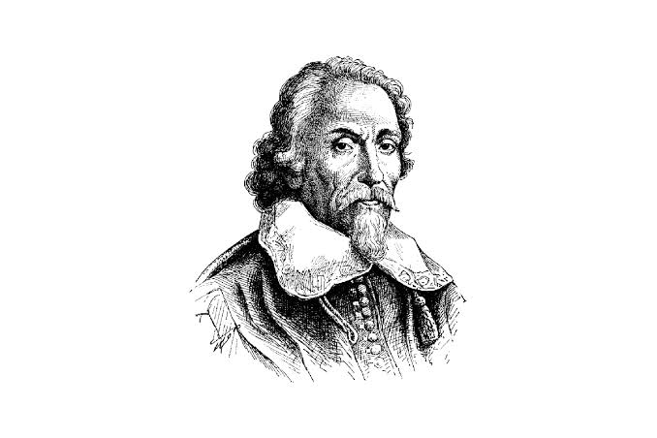
… It all began in 1628:

Slide 5
The Circulation is, in fact … a Circle.
… and circles are hard to understand.

Slide 6
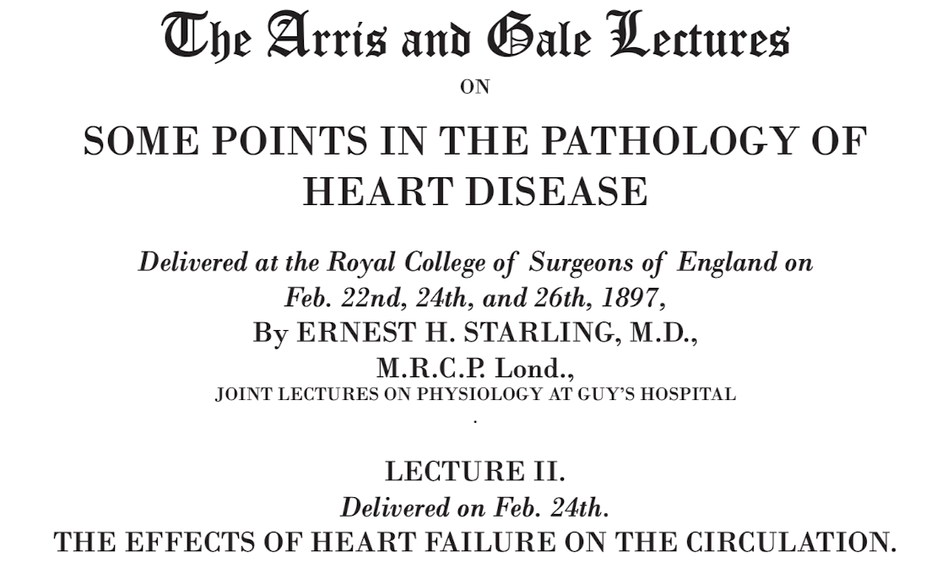
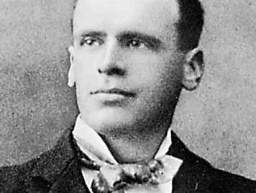
… and continued in 1897:

Slide 7
And, within that circle, there is a magical
Point:

Slide 8
“Somewhere in the circulation there must be a point where the pressure is neither raised nor lowered and where, therefore, the pressure is independent of cardiac activity.”
- Ernest Starling, 1897

Slide 9
Ernest Starling called the pressure at that magical point
“Mean Systemic Pressure”
or “P_{ms}”
Importantly:
P_{ms} is also circulatory arrest pressure.

Slide 10
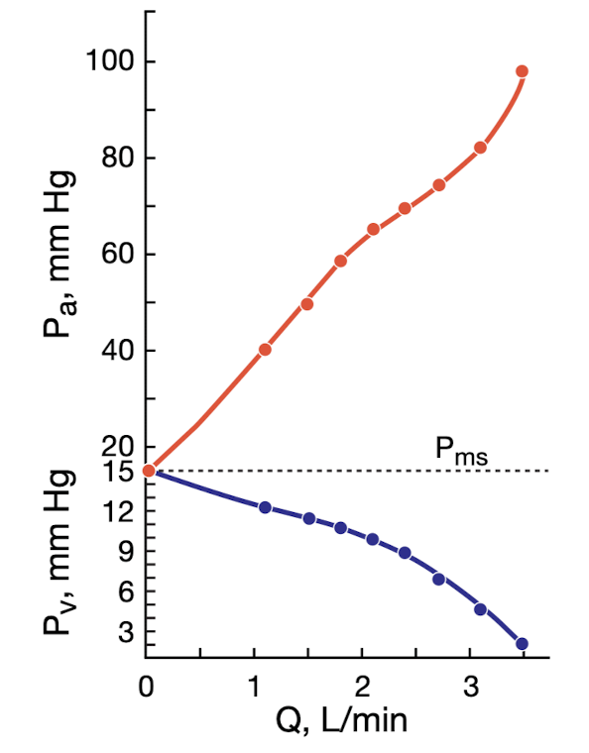
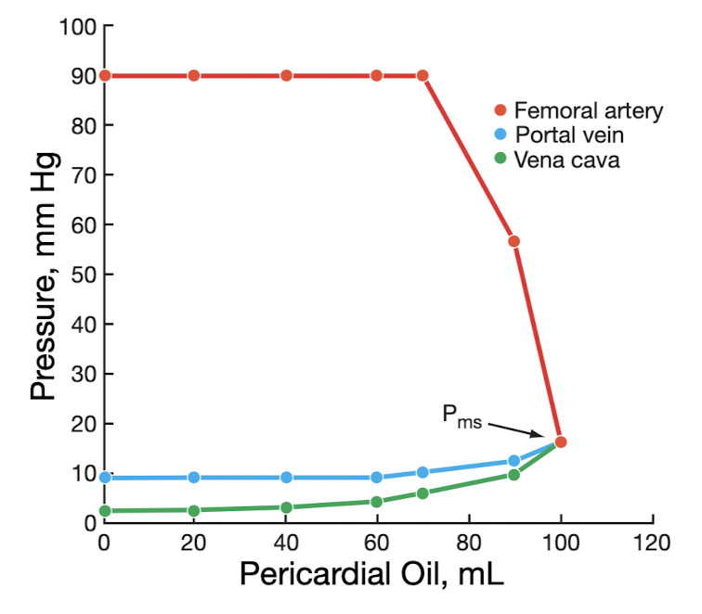
Starling, 1897
Levy, 1979
From: Munis, 2012

Slide 11
Starling, 1897
Levy, 1979
Mirror
Image
From: Munis, 2012

Slide 12
P_{ms} is also the gold standard for
relative blood volume,
i.e., “How full is the CV System?”

Slide 13
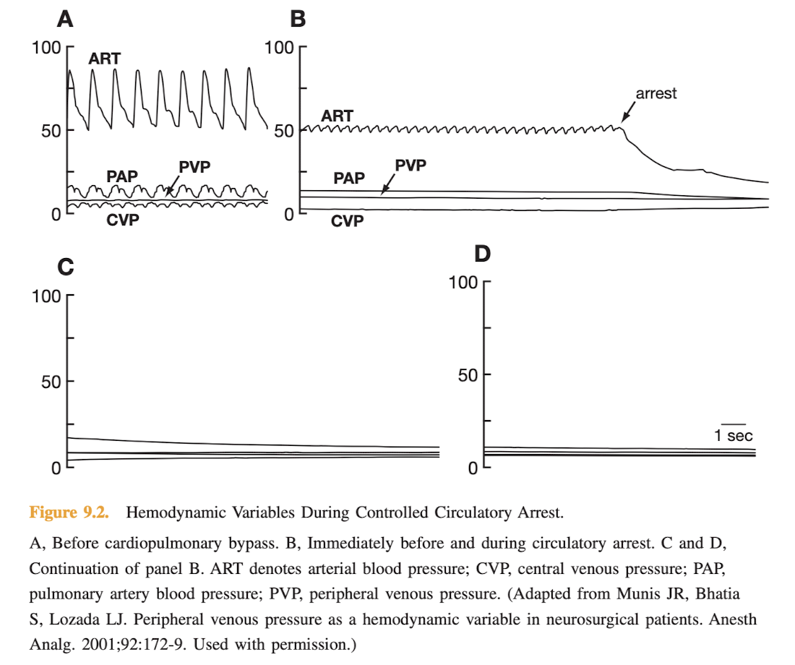
… And, P_{ms} can be
measured without the inconvenience of arresting the heart.
It is simply
Peripheral Venous Pressure (PVP):
From: Munis, 2012

Slide 14
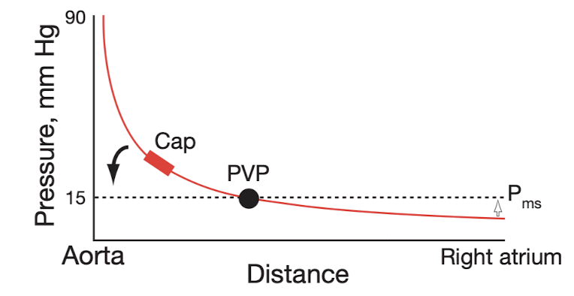
The Gold Standard of Volume Assessment: P_{ms}
P_{ms} = (V-V_{o})/C
… and …
P_{ms} = PVP
From: Munis, 2012

Slide 15
But, before we integrate all of this and come to the REV Vector, you’ll need to be fluent in
The Language of the Body:
When it comes to monitoring and controlling Cardiovascular Function, the body speaks a different language than we speak:
It speaks the Language of STRETCH.

Slide 16
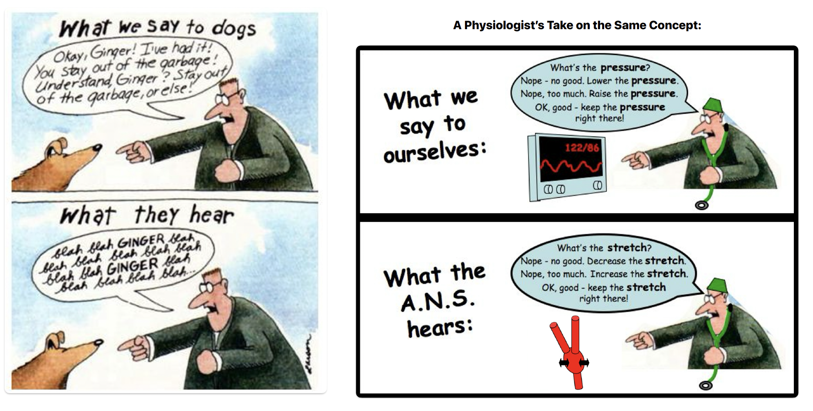
The Language of the Body is: S-T-R-E-T-C-H
A Physiologist’s Take:

Slide 17
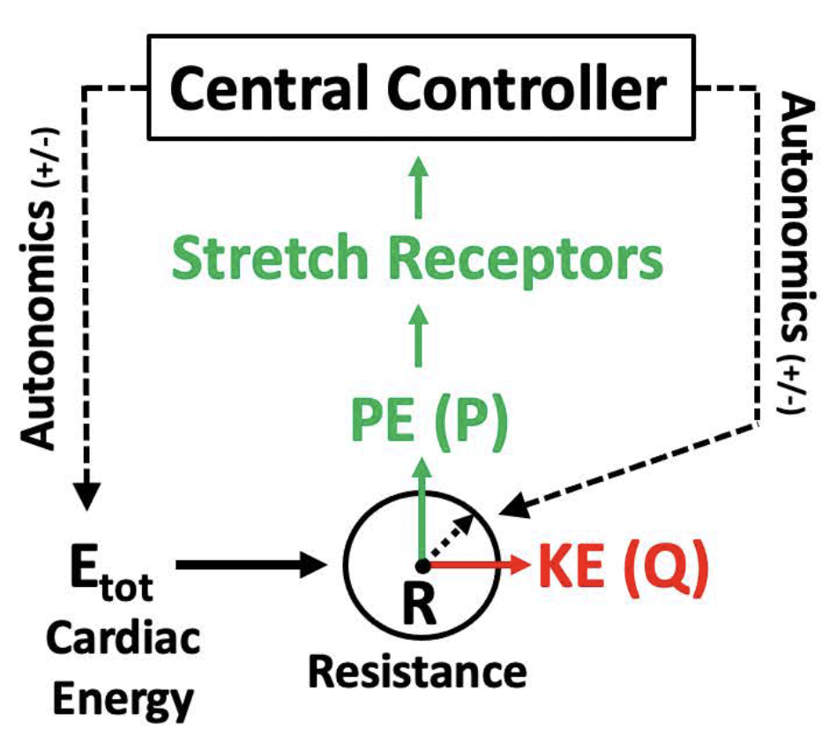
(View in Slide Show Mode to see Animation)
The REV Vector
Energy
Resistance
Volume
Energy
P
Afferent (Sensed):
Stretch
Efferent (Controlled):
Energy (HR x Inotropy)
Resistance
Volume
Resistance
Volume (PVP)
Q

Slide 18
A Deeper Dive into Energetics:

Slide 19
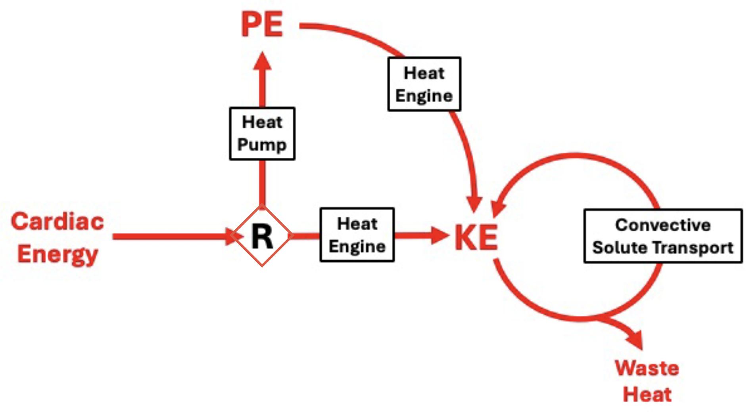
The CV System as a Combined
Heat Pump and Heat Engine:
(Work)

Slide 20
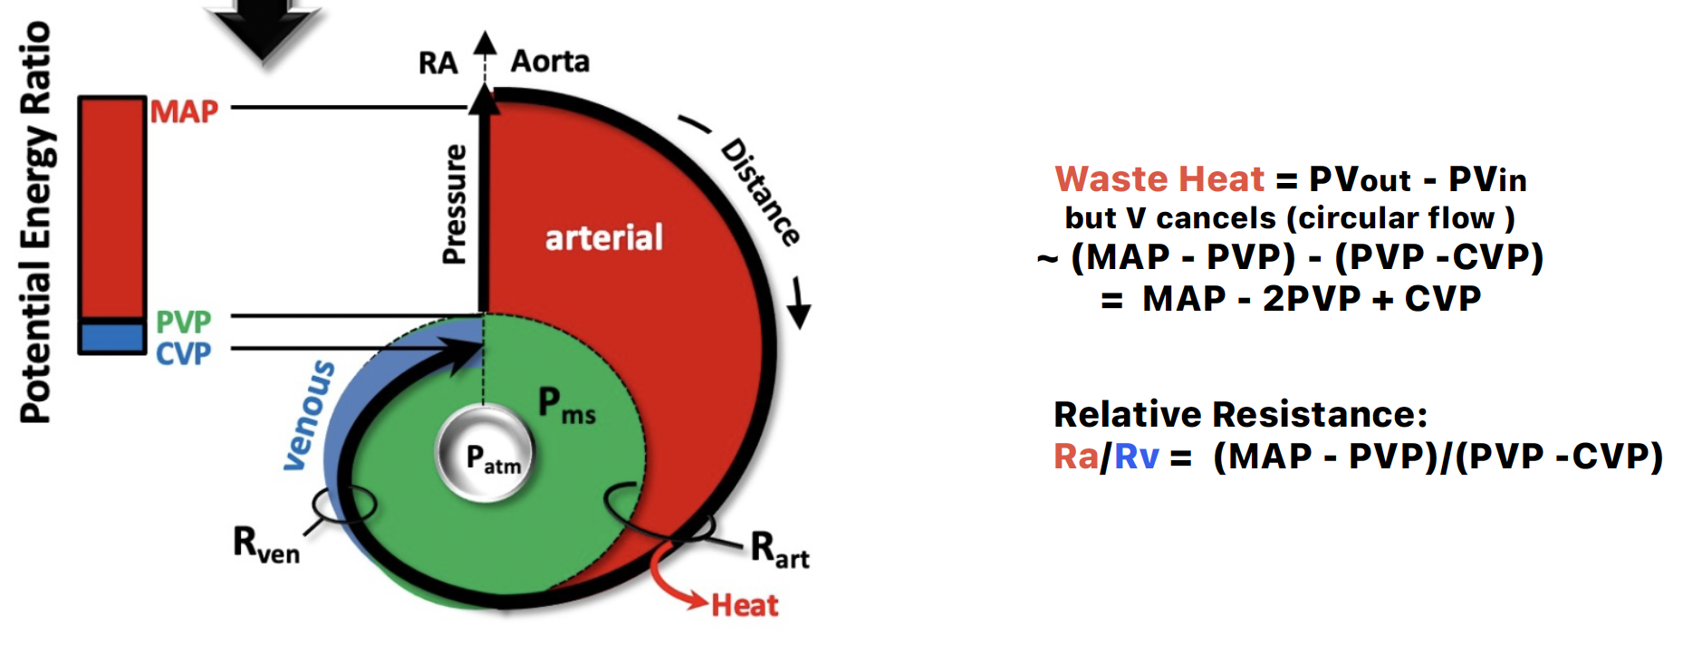
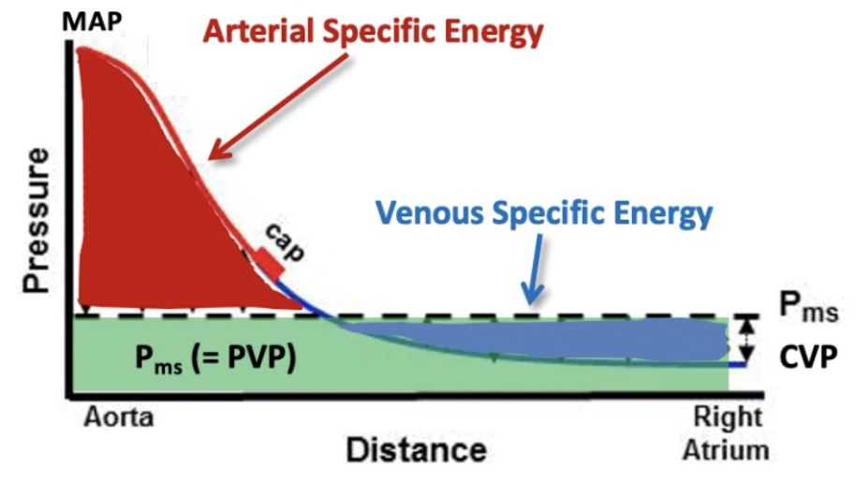
Keep the Energy Concept, but Don’t Forget that
the CV System is a Circle:

Slide 21
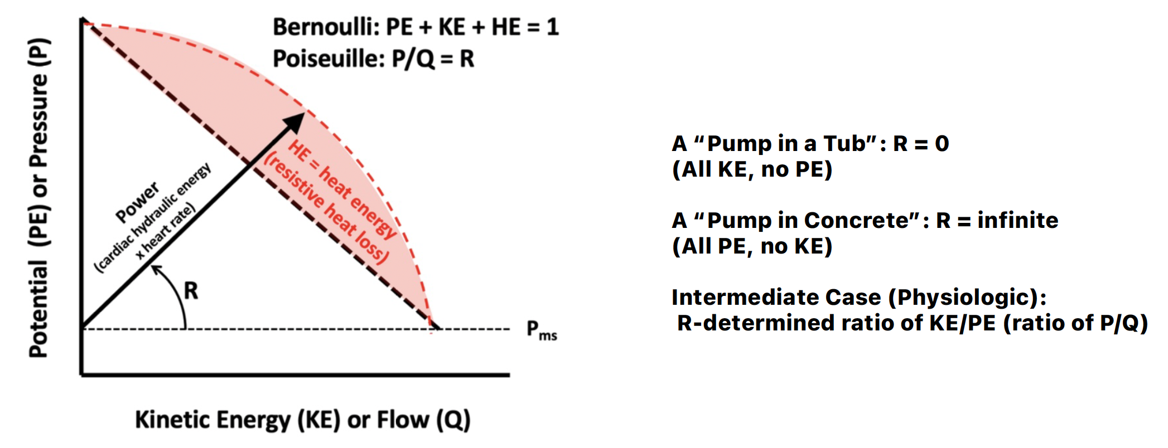
The REV Vector gives you Bernoulli and Poiseuille
in the same package:
Constant

Slide 22
Back to the REV Vector:
It keeps the Circle.
It includes Blood Volume.
It takes into account Energy.
It speaks the Language of the Body in terms of Cardiovascular Control.
It is a Simple, Integrated Visual Tool.

Slide 23
(View in Slide Show Mode to see Animation)
The REV Vector
Energy
Resistance
Volume
Energy
P
Afferent (Sensed):
Stretch
Efferent (Controlled):
Energy (HR x Inotropy)
Resistance
Volume
Resistance
Volume (PVP)
Q

Slide 24
References:
Harvey W. On the motion of the heart and blood in animals (1628). London: G.P. Putnam’s Sons; 1897. Translated by Robert Willis
Guyton AC. Determination of cardiac output by equating venous return curves with cardiac response curves. Physiol Rev 1955; 35: 123- 9
Munis JR. Just enough physiology. New York, NY: Oxford University Press/Mayo Clinic Scientific Press; 2012
Starling EH. Some points in the pathology of heart disease. Lancet 1897; 149: 652-5
Munis JR, Bhatia S, Lozada LJ. Peripheral venous pressure as a hemodynamic variable in neurosurgical patients. Anesth Analg 2001; 92: 172-9
Levy MN. The cardiac and vascular factors that determine systemic blood flow. Circ Res 1979; 44: 739-47
Munis JR. A return to the venous return controversy: a visual aid for combatants. Am J Physiol Heart Circ Physiol 2013; 304: H487-8
Munis JR. The value of circular reasoning: what Harvey taught, and we forgot. Br J Anaesth 2024; 132: 649-52

