Slide 1
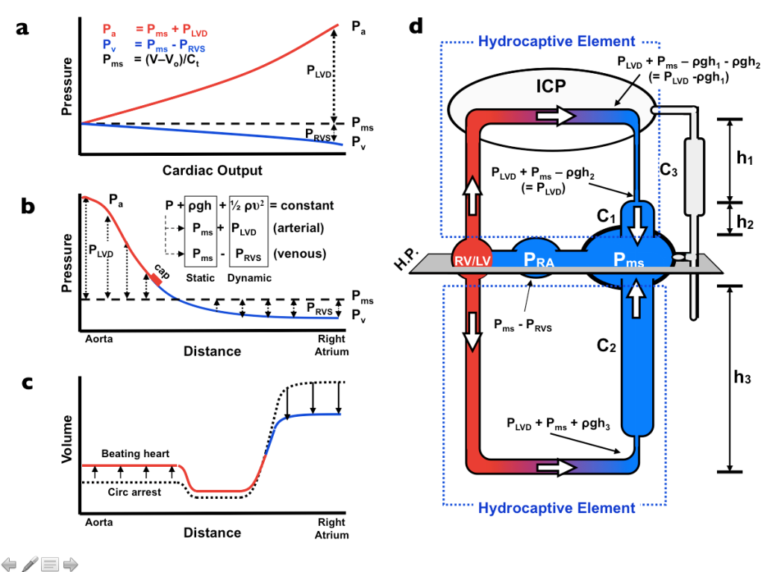
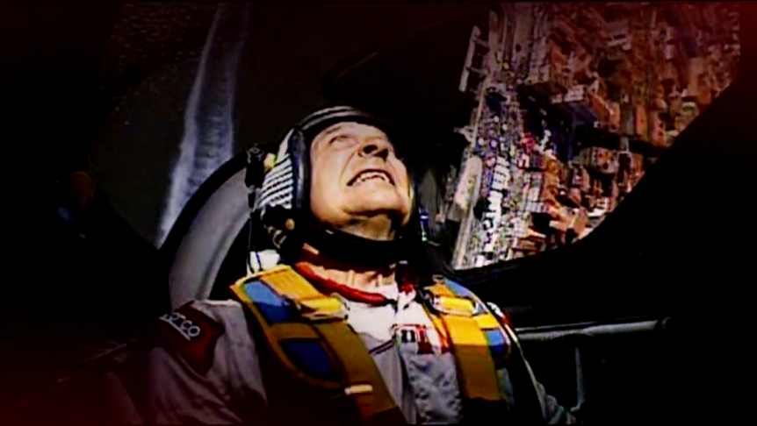
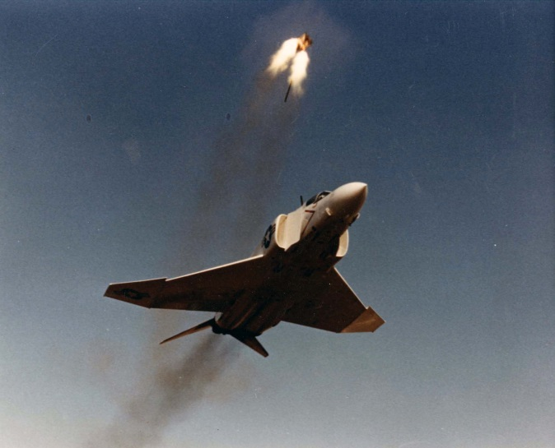
Acceleration and the Human Body
History, Physiology, and Pathophysiology
Civil Aviation Medical Association (CAMA) 2016 Keynote
James Munis, MD, PhD
Departments of Anesthesiology,
Physiology & Biomedical Engineering
Mayo Clinic Rochester

Slide 2

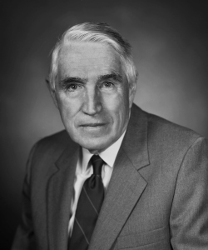
Fighting the Axis
….. by Fighting the axis
Earl Wood, Gravity, and the Mayo Aero Medical Unit

Slide 3
Be sure to view following presentation in
Full Slide Show Mode

Slide 4
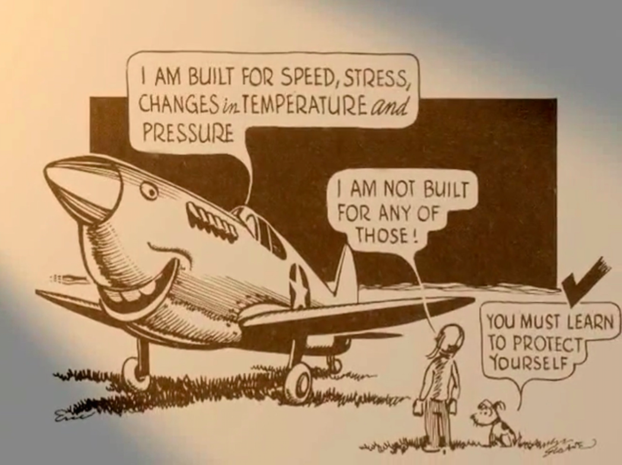
The Problem::
Copyright © 2002 Mayo Foundation

Slide 5
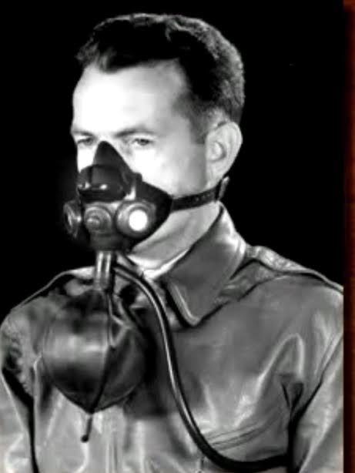


PROBLEM:
SOLUTION:
Too Little Oxygen
Too Many g’s
M-1 Maneuver
G-Suit

Slide 6

“We had nothing to match it, and I knew, if American aviation science was so far ahead of us to make such a suit, Germany had already lost the war.”
- Willy Messerschmitt

Slide 7

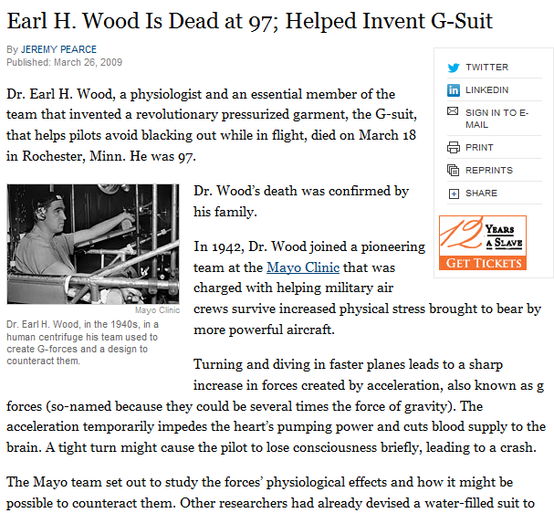

Slide 8
Brains
Hearts
Guts

Slide 9
Guts

Slide 10

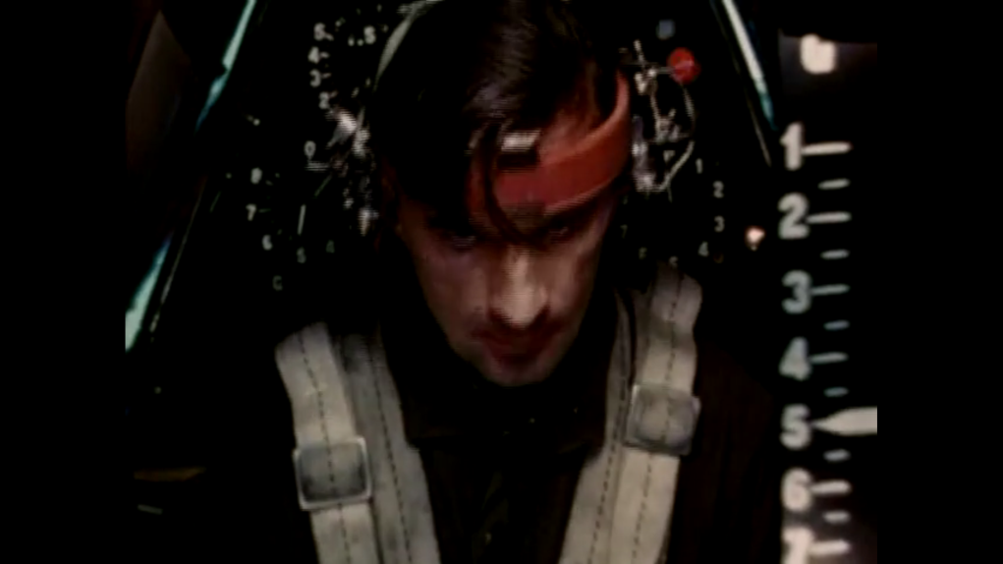
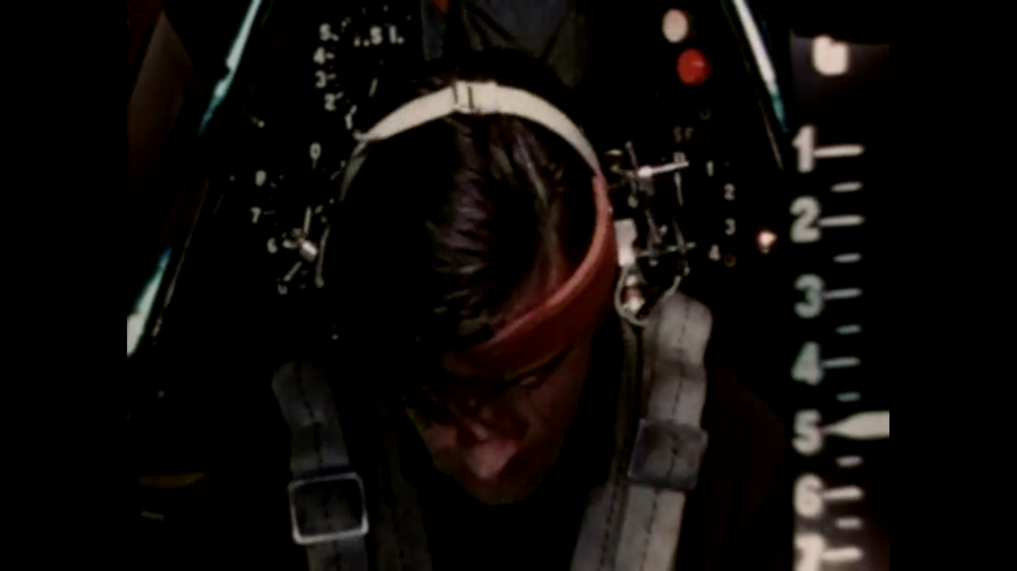
+1g Normal
+2g Face sags
+3g Can’t stand
+5g Can’t see
+8g Can’t move
+12g Can’t think
G-LOC

Slide 11
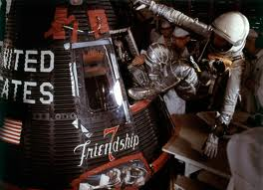
1962 – John Glenn (Mercury Friendship 7)
+6g for 90 sec
+8g transiently

Slide 12

1983 – Soyuz 7K-T 39
(separation failure between stages 2/3)
+21g during re-entry

Slide 13

Military Aircraft (ejection)
+25g

Slide 14
Brains

Slide 15

Is there more to G-LOC
than lack of O₂?

Slide 16
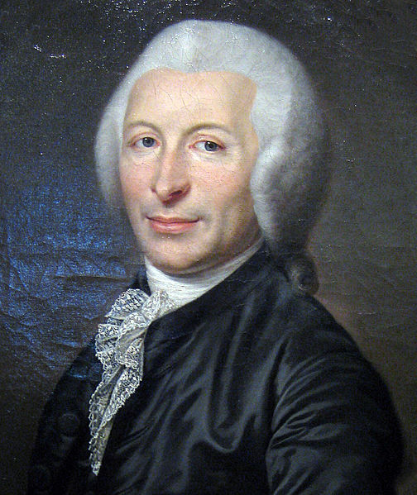
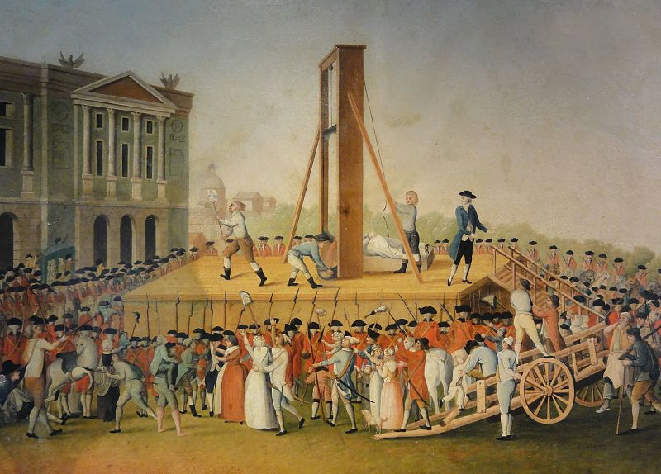
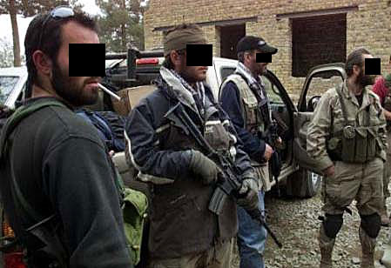

Slide 17
A choke-out maneuver results in
loss of consciousness (LOC)
in 3-4 sec.
… so, there’s more going on than a simple lack of cerebral blood flow and O₂
Let’s have a look at asystole and the dive reflex:

Slide 18
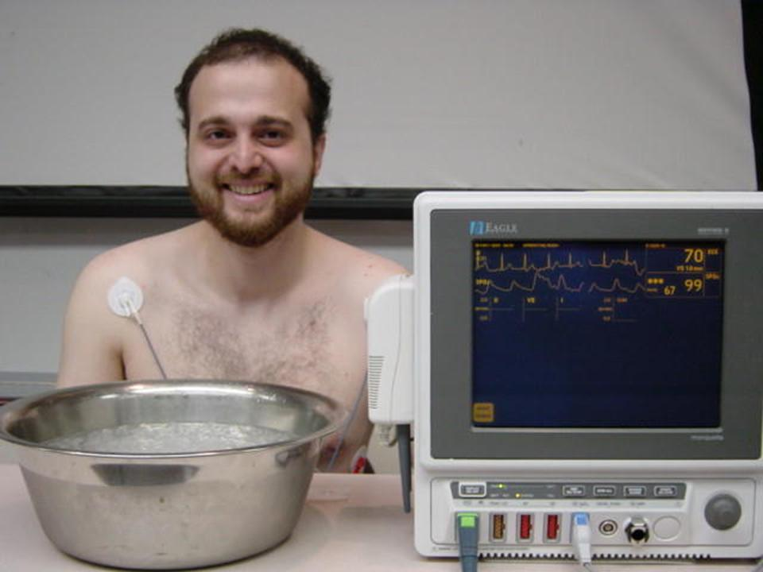

Slide 19
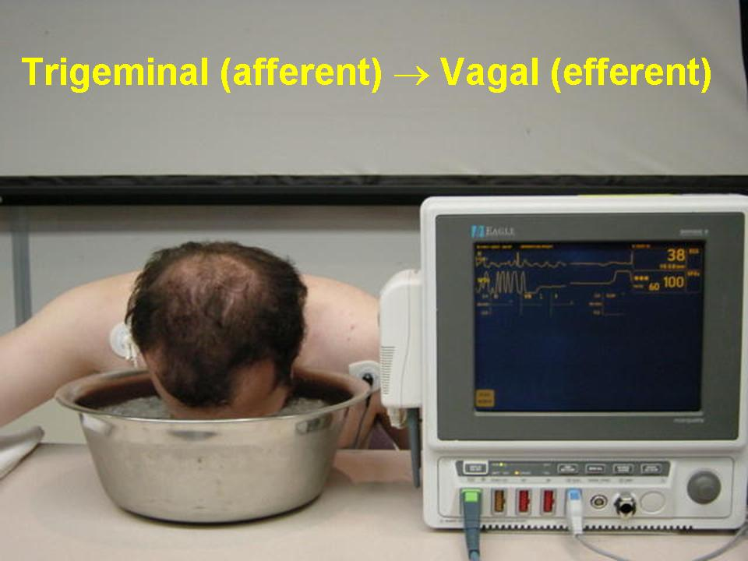
Asystole
But … still fully conscious, hearing & responsive after 12 sec at zero cerebral blood flow.

Slide 20
+1g Normal
+2g Face sags
+3g Can’t stand
+5g Can’t see
+8g Can’t move
+12g Can’t think

Slide 21
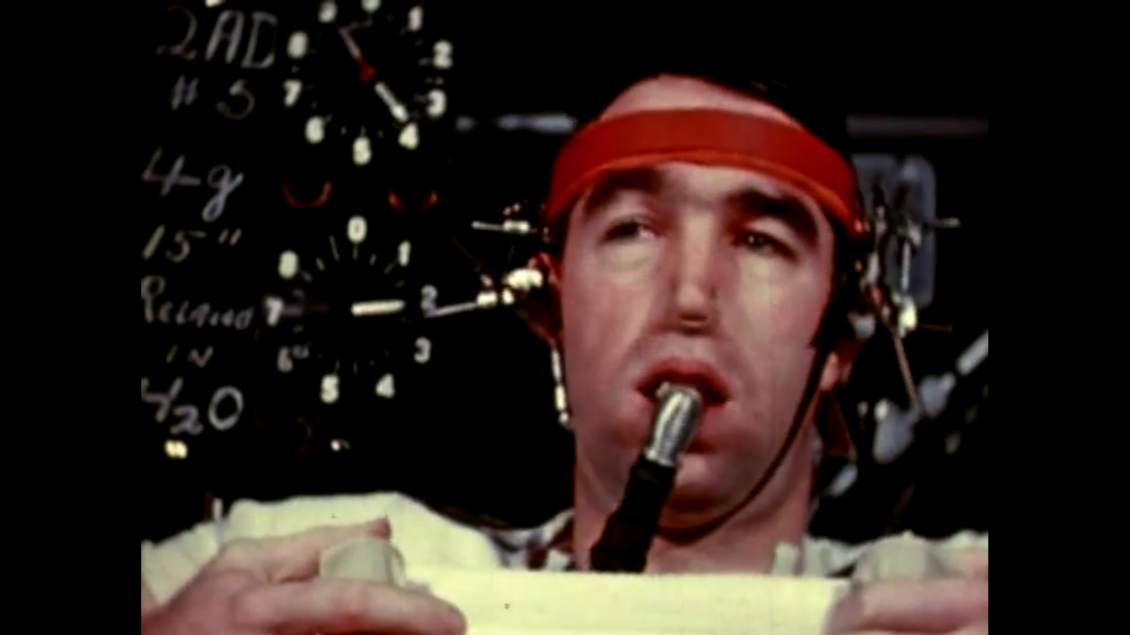
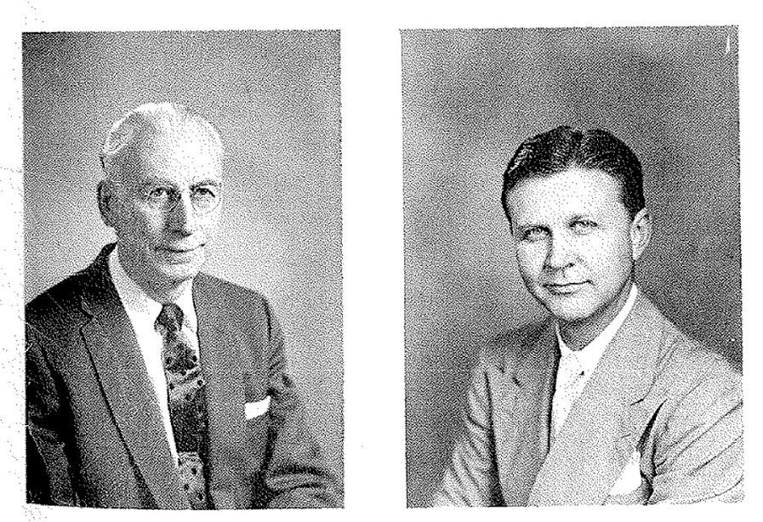
E. H. Wood, MD PhD
E. J. Baldes, PhD
C.F. Code, MD

Slide 22
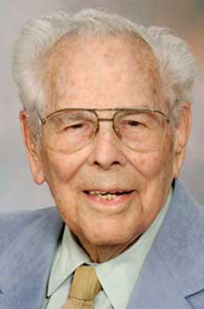
Dr. Henry (Fred) Helmholz
1911 - 2012

Slide 23
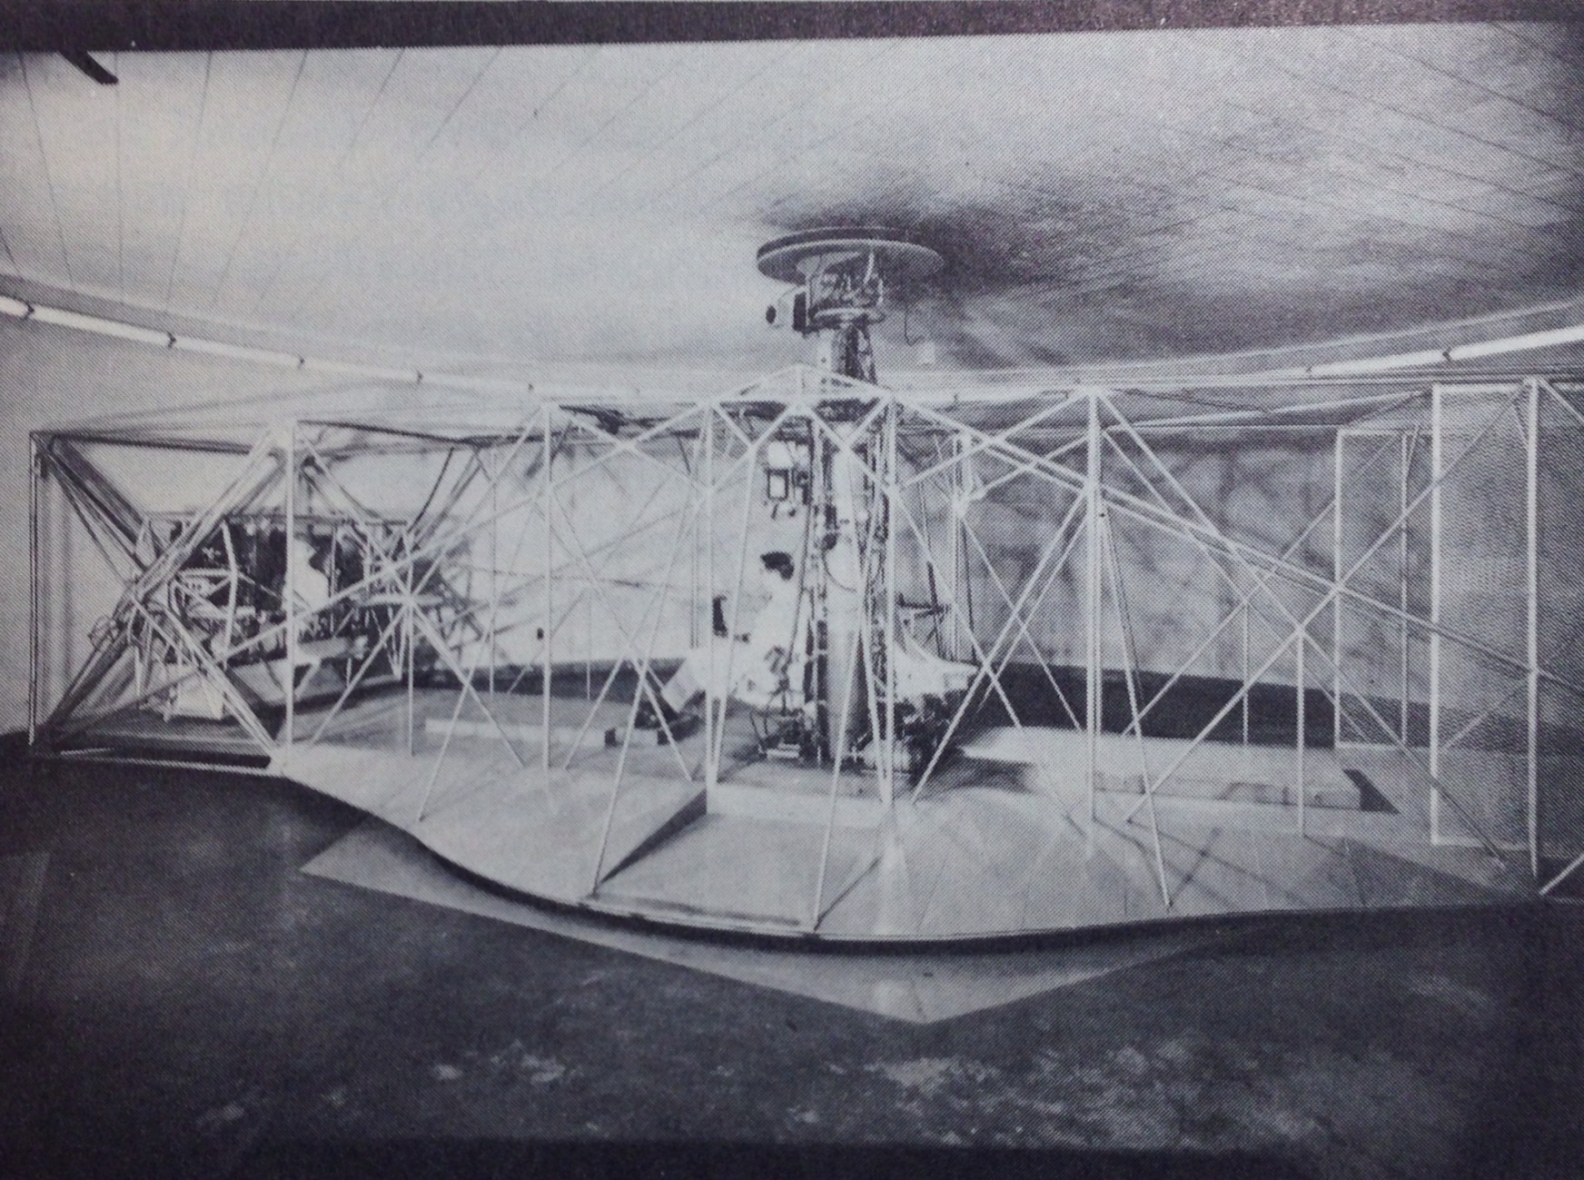
300 Subjects; 10,000 Rides
Lindberg EF & Wood EH, 1963

Slide 24
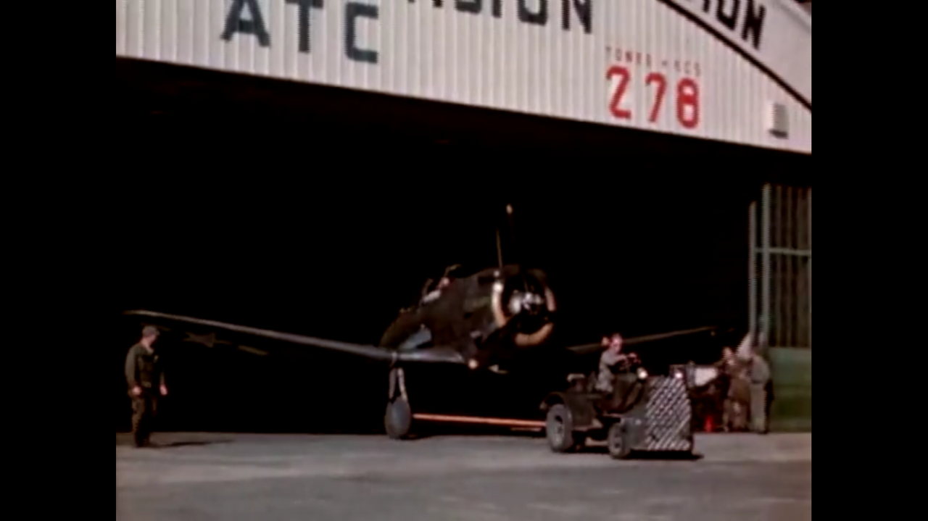
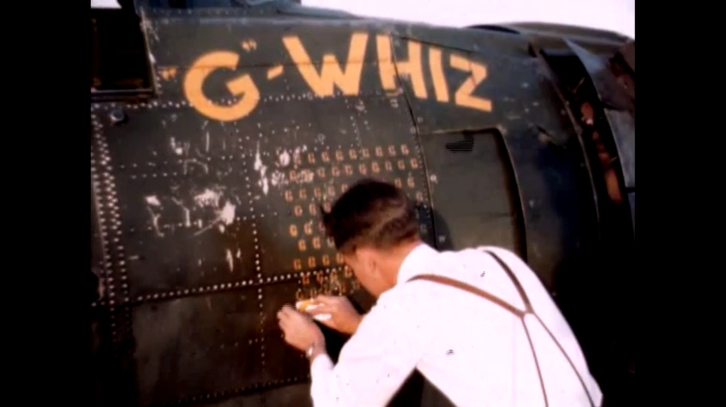

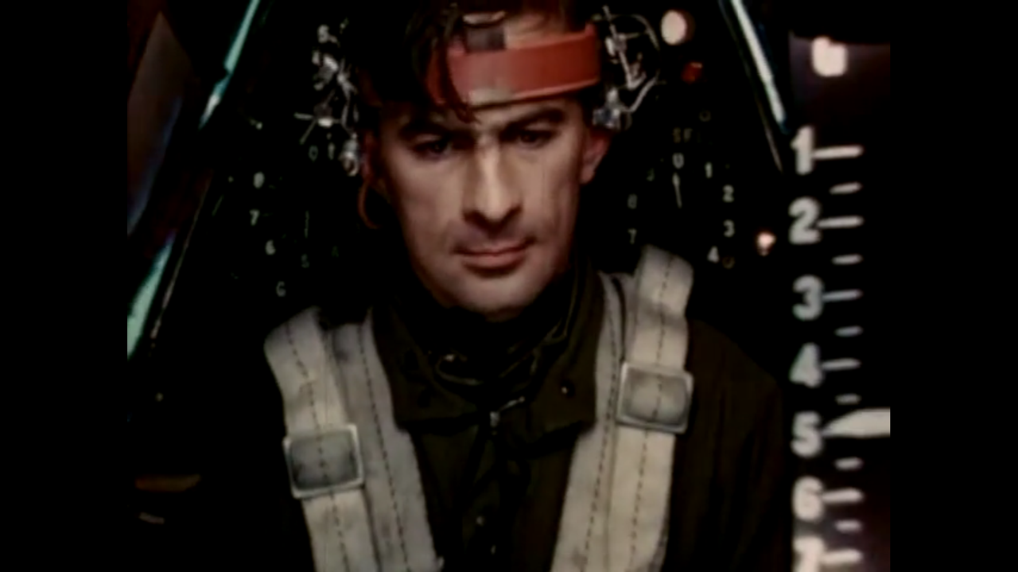

Slide 25
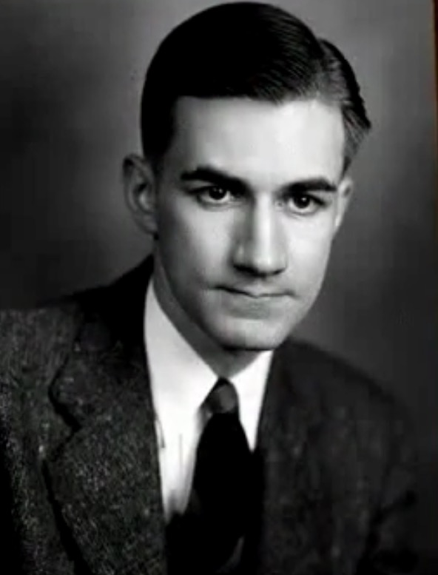
Edward Lambert, MD PhD

Slide 26
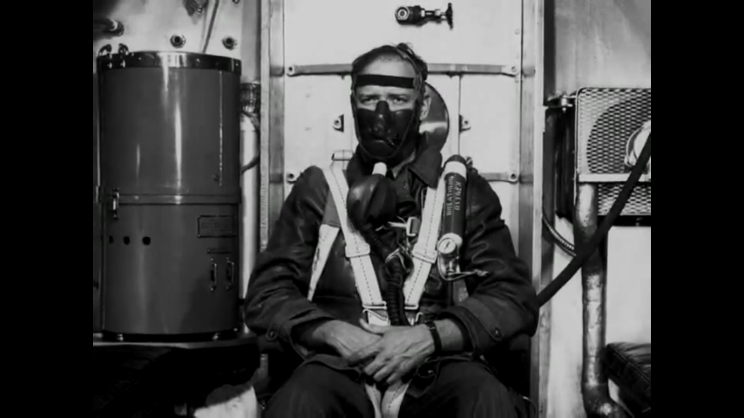

Slide 27
Hearts

Slide 28
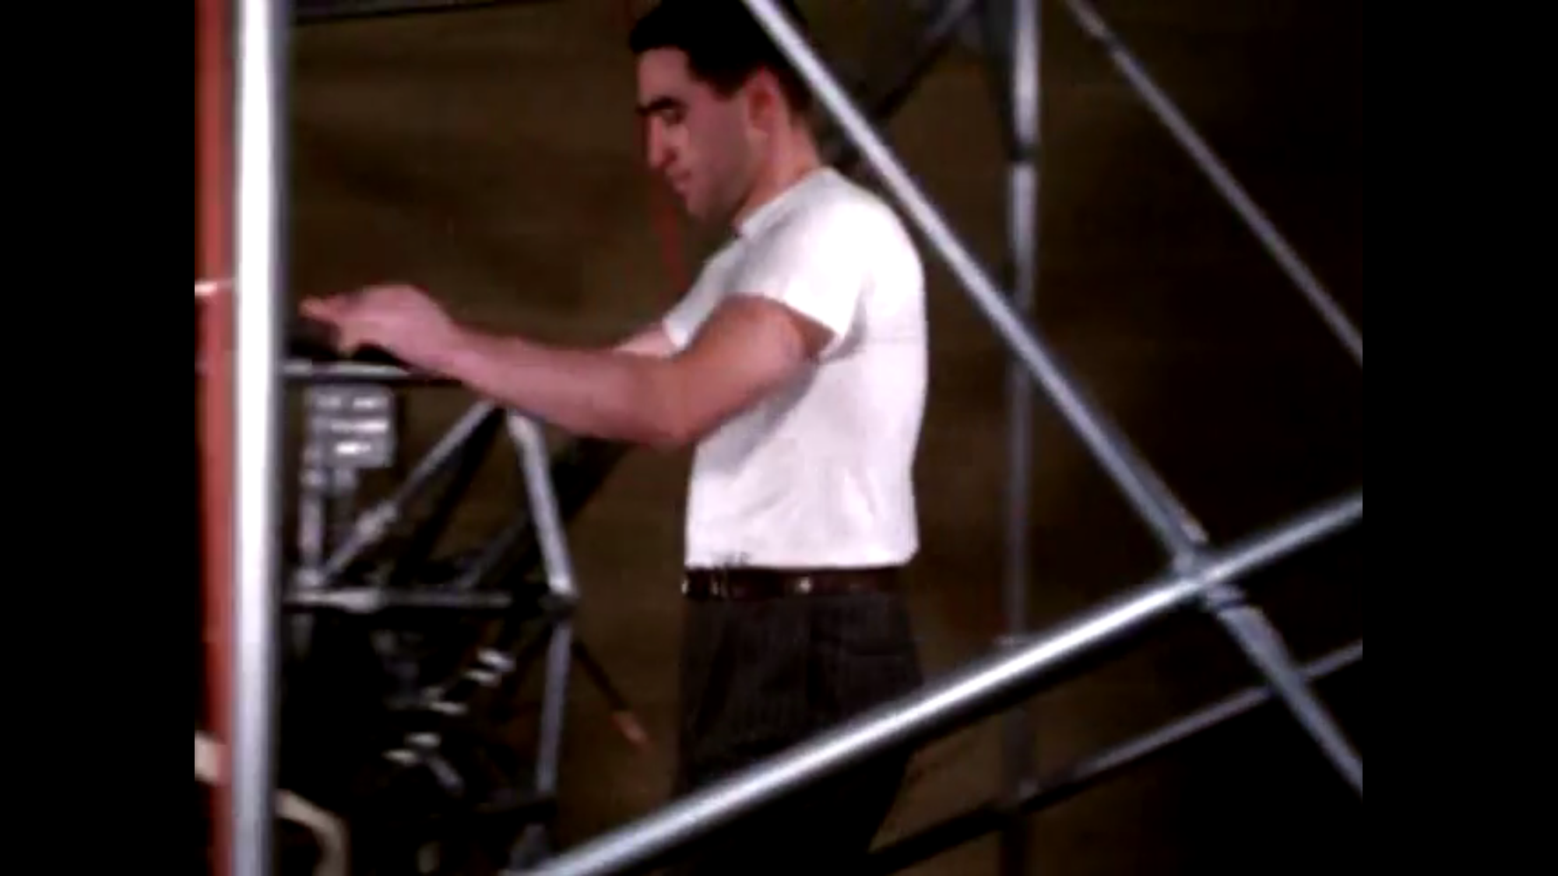

Slide 29

Ross Campion
Lincoln Eckman

Slide 30
… So, what happened in that centrifuge?

Slide 31
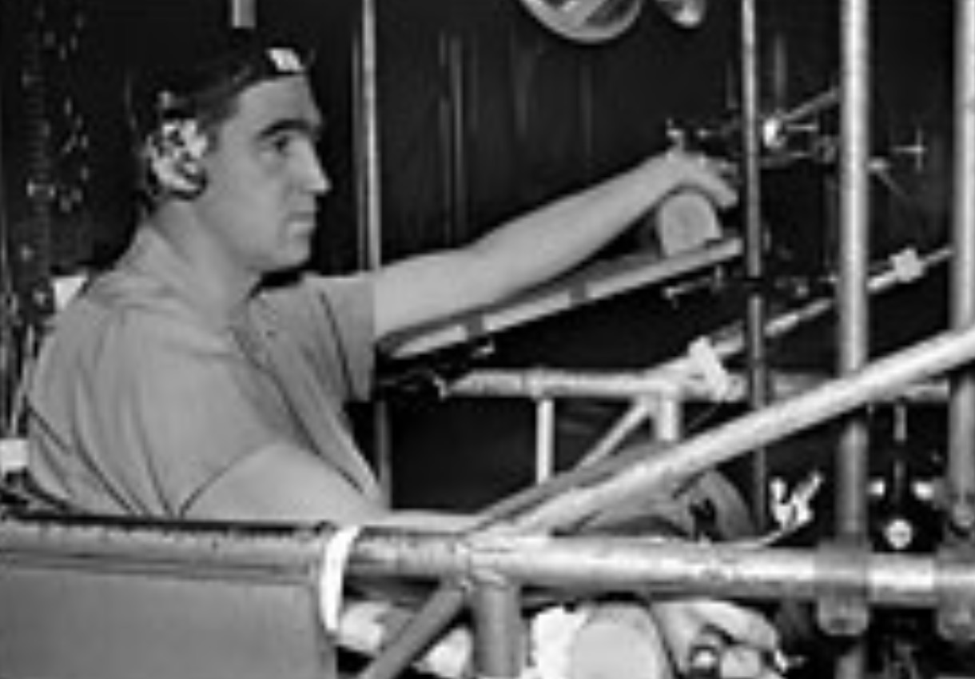
Lindberg EF & Wood EH, 1963

Slide 32
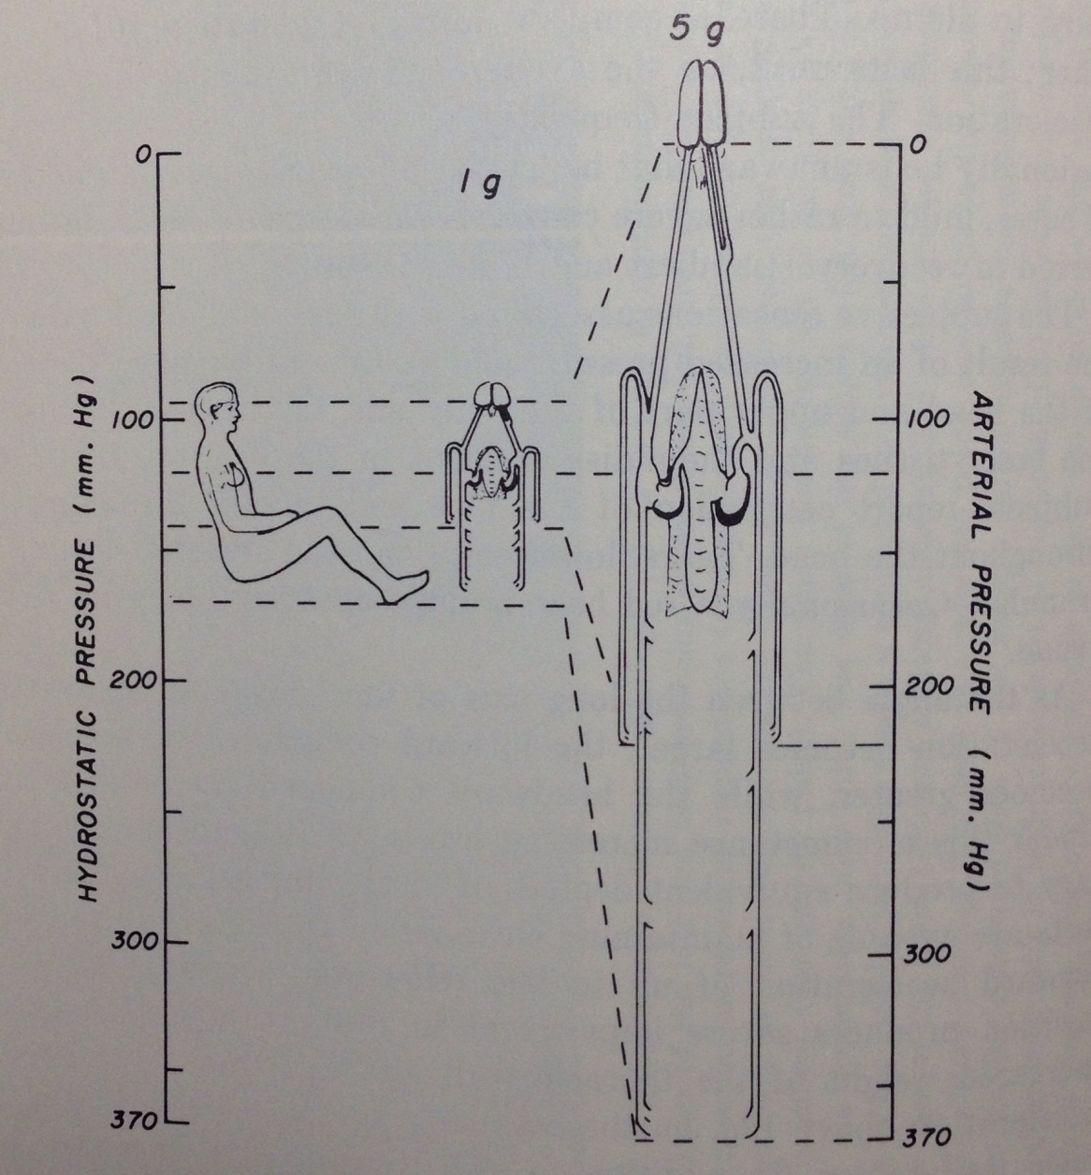
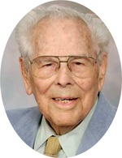
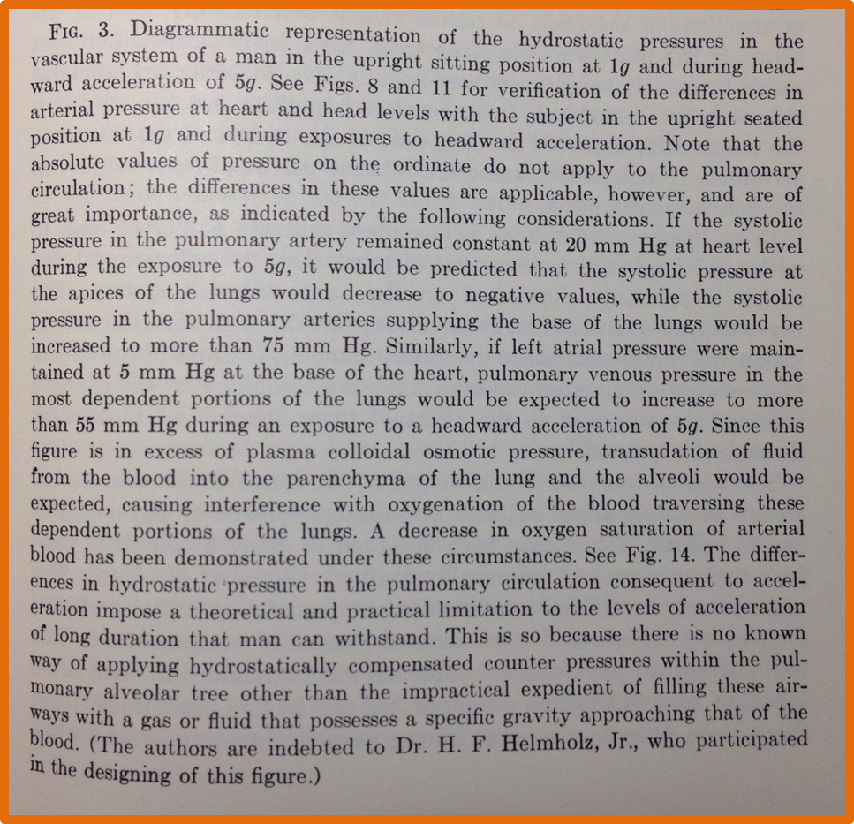
Henry (Fred) Helmholtz, MD
1911 - 2012
Lindberg EF & Wood EH, 1963

Slide 33
Lindberg EF & Wood EH, 1963

Slide 34
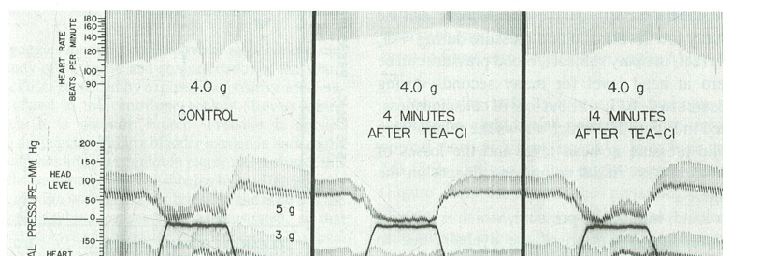
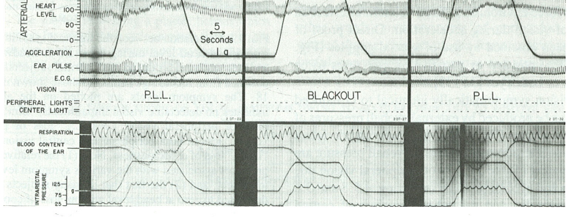
Lindberg EF & Wood EH, 1963

Slide 35


Slide 36
Principle # 1:
Blood vessels in the brain are hard to collapse.

Slide 37
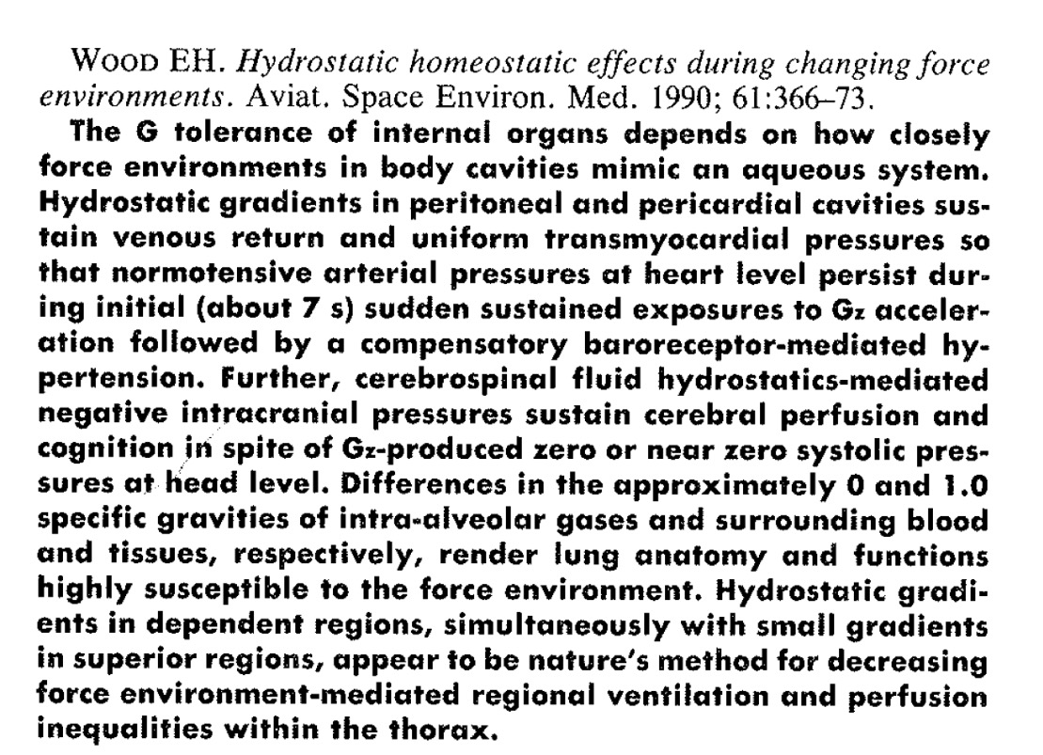

Slide 38
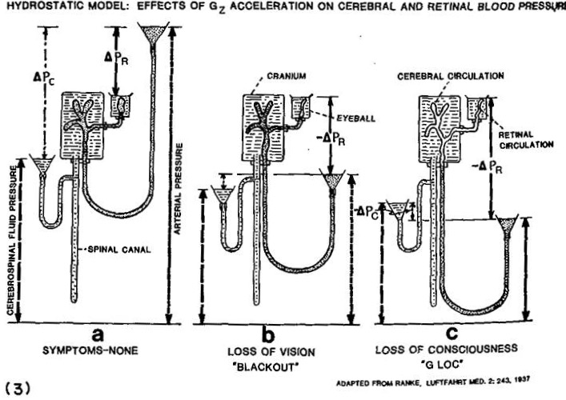
From: Wood, EH (1989) after Ranke, O (1938)

Slide 39
OPEN
Air
Air
OPEN
Water

Slide 40
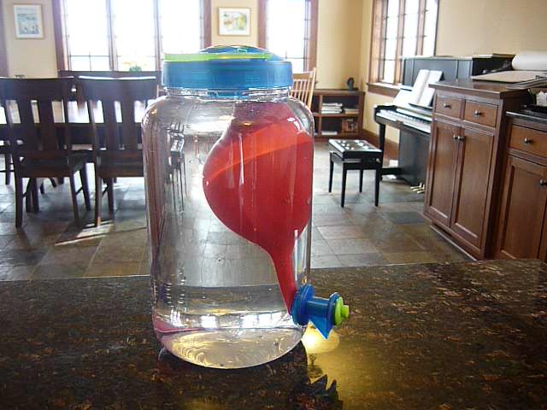

Slide 41
Principle # 2:
Pressure is something, not nothing

Slide 42

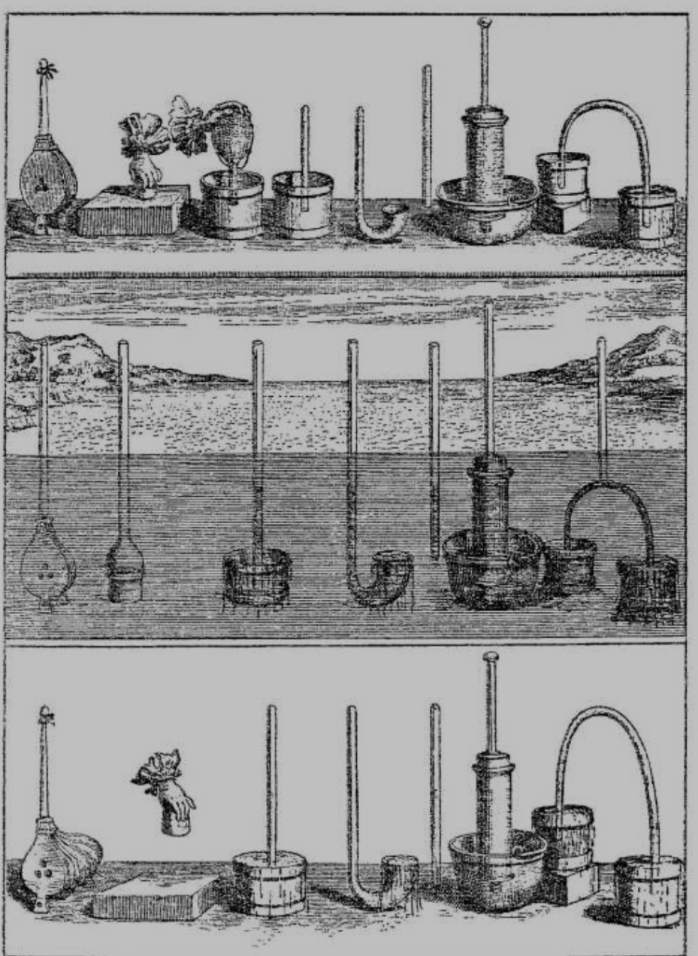
Blaise Pascal
1642

Slide 43



Air
Siphon
Vacuum
Air
Transducer
= 0
= 0
Transducer
Transducer

Slide 44
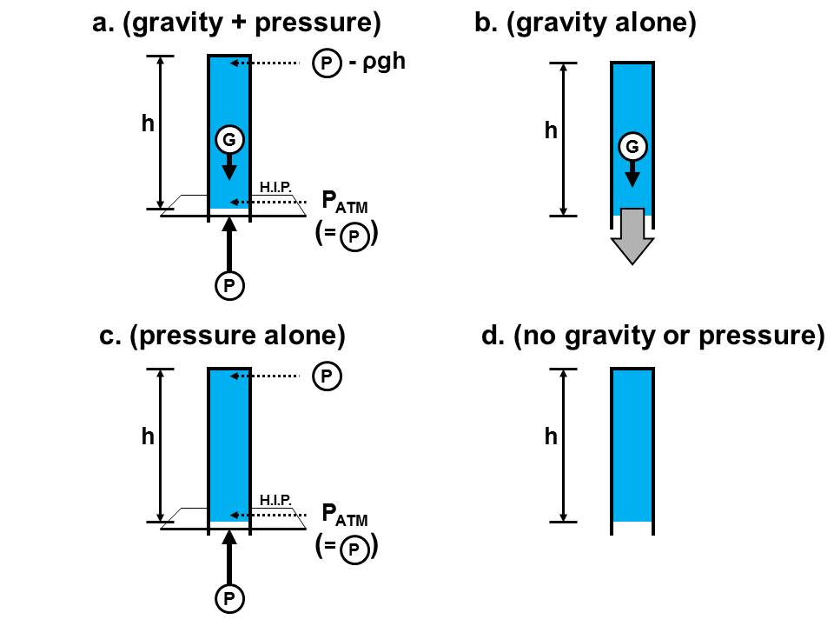
Munis

Slide 45
Given principles # 1 and # 2,
How do we model
the cardiovascular system?

Slide 46
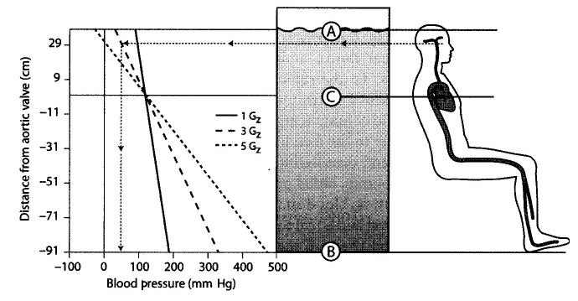
Q: Do Humans behave like an open can of fluids?
WRONG
From: Aerospace Medicine, 2008
A: No. We behave like closed cans of fluids
… with some soft parts

Slide 47


2g
1g
Gravitational Vector
(-)
ATM
(+)

Slide 48
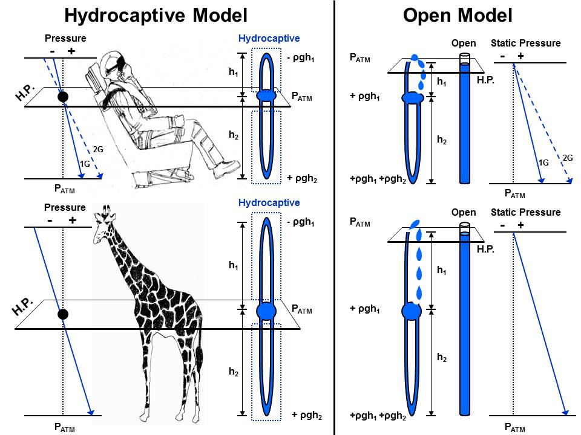
Munis

Slide 49
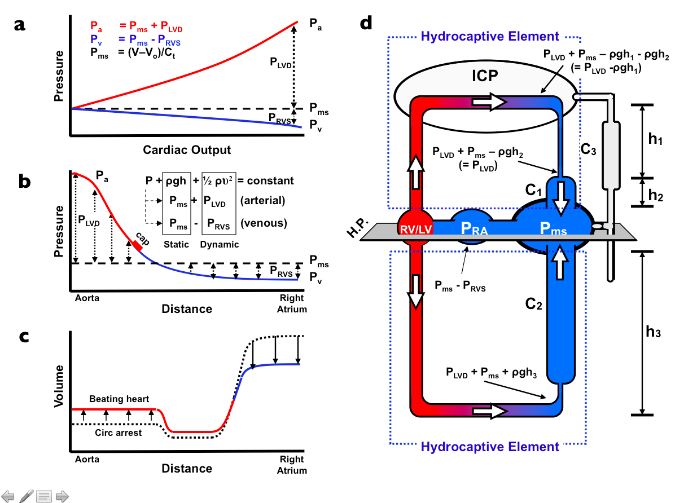
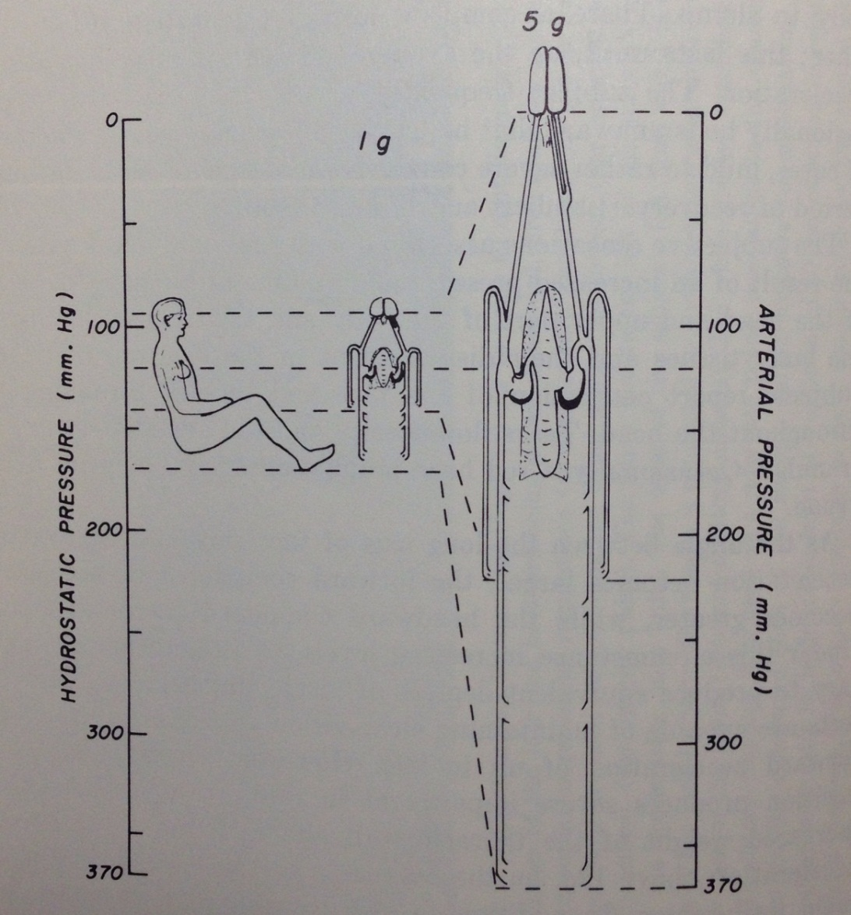
Lindberg EF & Wood EH, 1963
Munis

Slide 50

What about G_{x} and G_{y} acceleration?

Slide 51
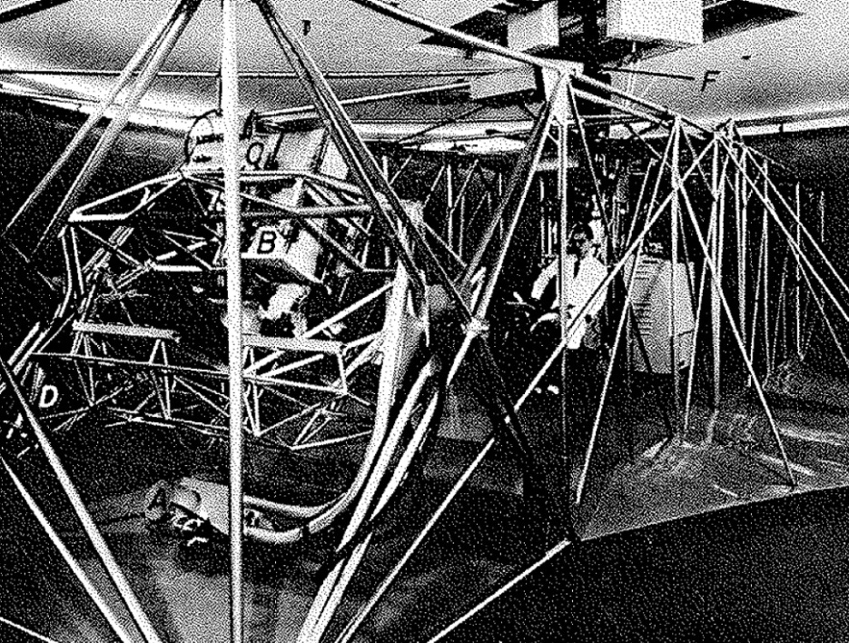
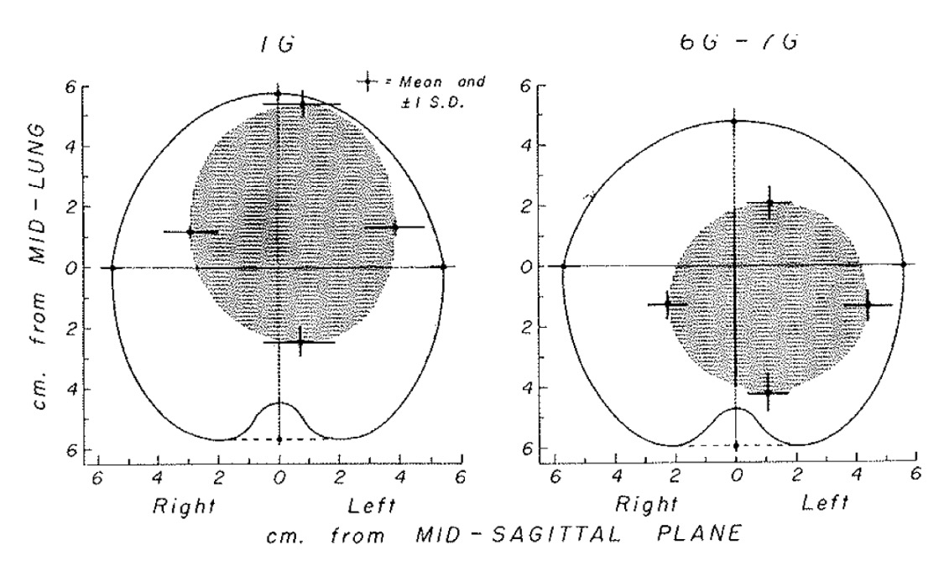
From: Rutischauser, Banchero, Tsakiris, and Wood, 1967

Slide 52
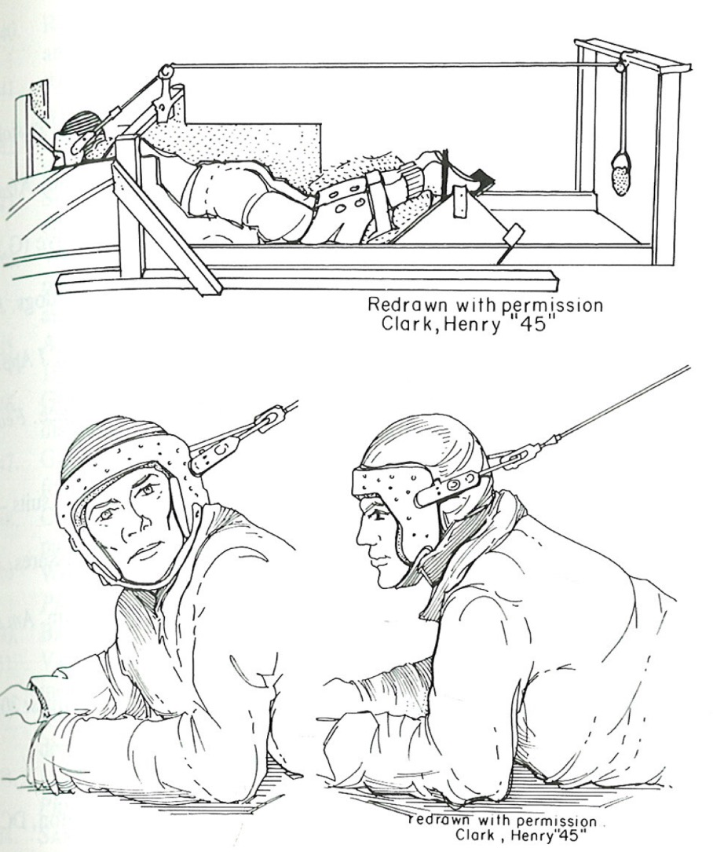
Wood EH, 1987

Slide 53
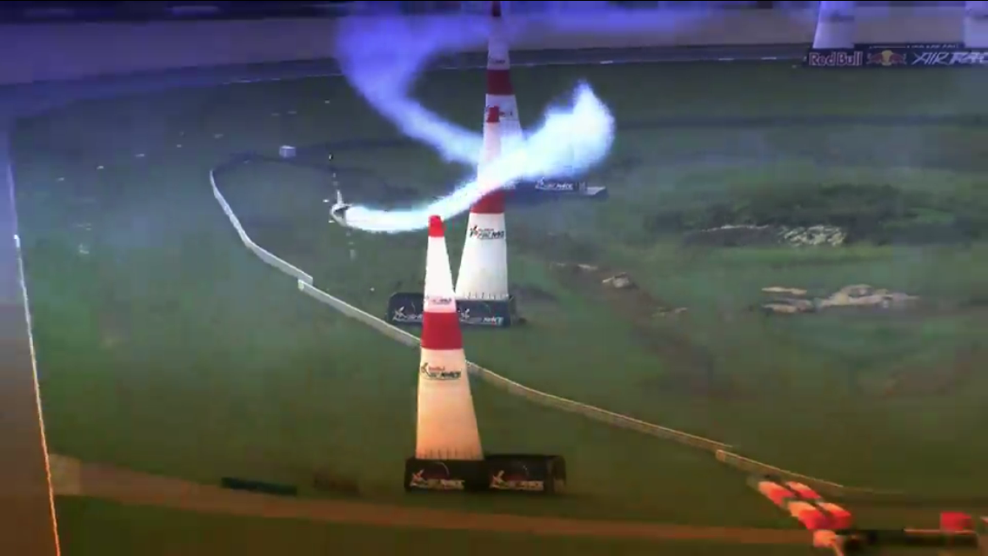

Slide 54
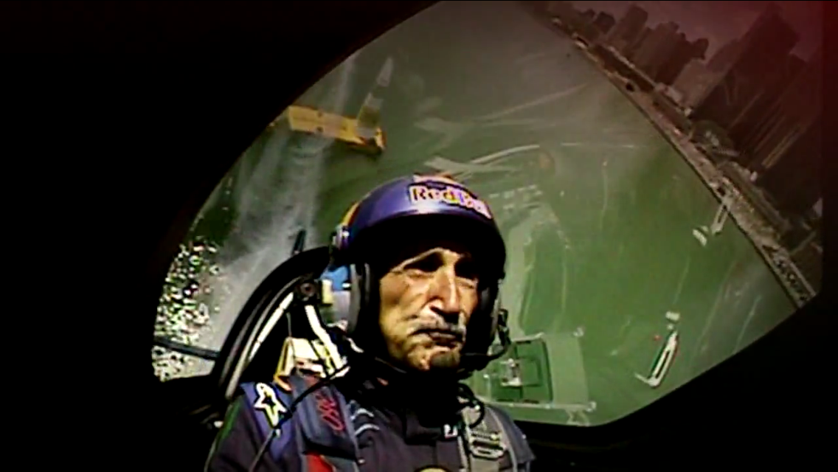

Slide 55


Slide 56
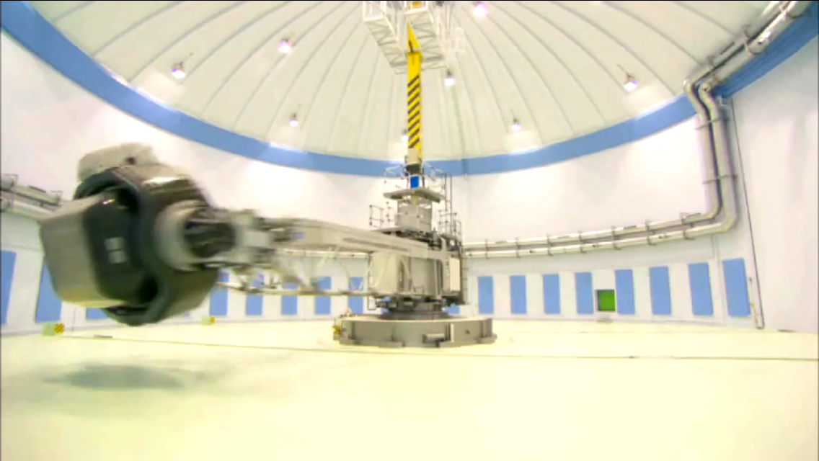
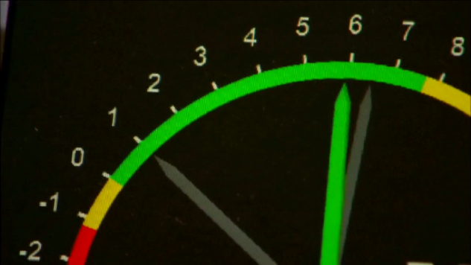

Slide 57
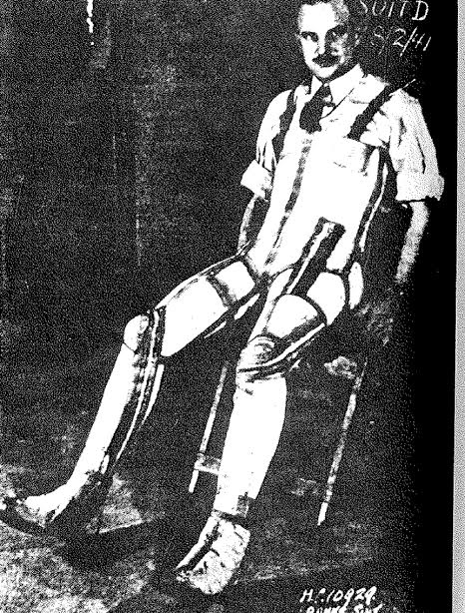

Franks anti-g Suit
1941
Mayo G-1 anti-g Suit
1943

Slide 58
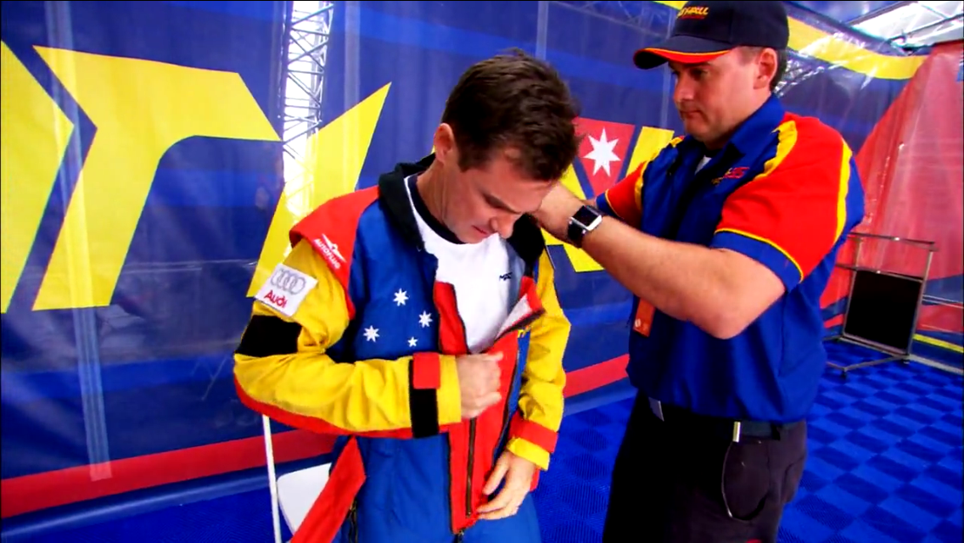
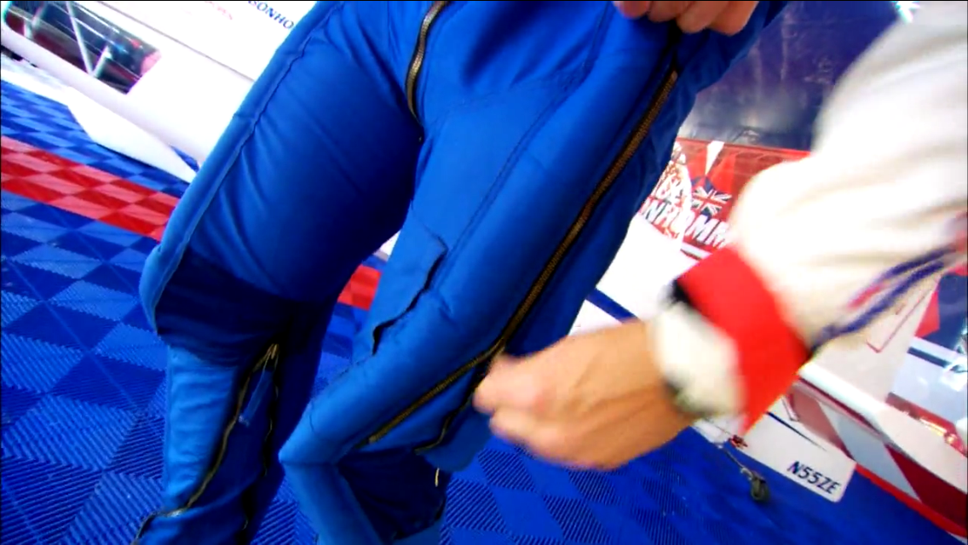
G-Racer Suit

Slide 59


2g
1g
Gravitational Vector
G-Race Suit
(-)
ATM
(+)

Slide 60


Slide 61

The Daily Physiologist
“There’s no new news, only old news happening to new people.”
- Malcolm Muggeridge
Debate continues as to indications for central venous pressure (CVP) monitoring in neurosurgical patients, with some practitioners suggesting that it should be standard of care for craniotomy patients; and others arguing that the risks and costs of widespread CVP placement outweigh the benefits for many or even most craniotomy patients. In this review, we will revisit the physiology of circulating blood volume in both normal and pathophysiologic states. This will allow our discussion of monitoring techniques to proceed from physiological principles rather than from individual prejudice and practice alone. As with other debates about monitoring in anesthesiology, we are handicapped by the virtual impossibility of demonstrating a difference in patient outcome between alternative techniques. The lack of an “outcome-based medicine” approach, however, does not mean that monitoring decisions are without consequence for our patients. In the case of CVP placement, the extra time, cost, and iatrogenic complications associated with the monitor are well described; and any possibility of an effective
There are several potential answers to that question, and each of them moves the discussion beyond volume alone. For example, oxygen carrying capacity is a function of total blood volume. So is the body’s efficiency in removing carbon dioxide and metabolic wastes a function of blood volume. Those two points, taken in isolation, would suggest that “the more blood volume the better,” however; without an obvious end in sight. The next answer might include considerations of circulatory efficiency as a function of total blood volume. After all, the circulatory system is just that – a conveyer belt, or convective transport system, and there must be some optimal blood volume where cardiac output is maximized. Too little volume, and the heart is “pumping empty” without an adequate priming volume (pre-load); but too much volume, and the capillaries leak while the heart fails from volume overload and without a significant drop in arterial blood pressure, the estimation of volume status become problematic. Sir Ernest Starling, over one hundre years ago, recognized t
indications for central venous pressure (CVP) monitoring in neurosurgical patients, with some practitioners suggesting that it should be standard of care for craniotomy patients; and others arguing that the risks and costs of widespread CVP placement outweigh the benefits for many or even most craniotomy patients. In this review, we will revisit the physiology of circulating blood volume in both normal and pathophysiologic states. This will allow our discussion of monitoring techniques to proceed from physiological principles rather than from individual prejudice and practice alone. As with other debates about monitoring in anesthesiology, we are handicapped by the virtual impossibility of demonstrating a difference in patient outcome between alternative techniques. The lack of an “outcome-based medicine” approach, however, does not mean that monitoring decisions are without consequence for our patients. In the case of CVP placement, the extra time, cost, and iatrogenic complications associated with the monitor are well described; and any possibility of an effective
debate continues as to indications for central venous pressure (CVP) monitoring in neurosurgical patients, with some practitioners suggesting that it should be standard of care for craniotomy patients; and others arguing that the risks and costs of widespread CVP placement outweigh the benefits for many or even most craniotomy patients. In this review, we will revisit the physiology of circulating blood volume in both normal and pathophysiologic states. This will allow our discussion of monitoring techniques to proceed from physiological principles rather than from individual prejudice and practice alone. As with other debates about monitoring in anesthesiology, we are handicapped by the virtual impossibility of demonstrating a difference in patient outcome between alternative

Slide 62


The End
James.Munis@gmail.com

